Slide 1
Software Engineering
Prepared by: Neha Tripathi

Slide 2
Prototyping Model
Throw Away Prototyping
Evolutionary Prototyping

Slide 3
Prototyping Model
Prototyping is defined as the process of developing a working replication of a product or system that has to be engineered. It offers a small scale facsimile of the end product and is used for obtaining customers feedback.
The Prototyping Model is one of the most popularly used Software Development Life Cycle Models (SDLC models).
This model is used when the customers do not know the exact project requirements beforehand.
In this model, a prototype of the end product is first developed, tested and refined as per customer feedback repeatedly till a final acceptable prototype is achieved which forms the basis for developing the final product.
Final Product is developed using Iterative Waterfall approach.

Slide 4
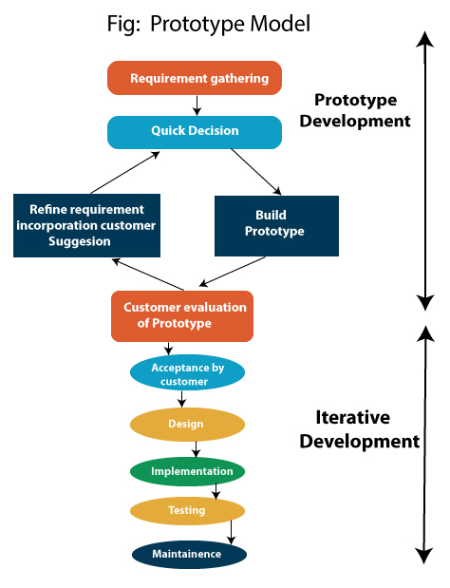
Prototyping Model-Representation

Slide 5
A prototype is a toy implementation of a system:
limited functional capabilities,
low reliability,
inefficient performance.
Small scale
Developed using shortcuts
Start with approximate requirements.
Carry out a quick design.
Prototype model is built using several short-cuts:
Short-cuts might involve using inefficient, inaccurate, or dummy functions.
A function may use a table look-up rather than performing the actual computations.
The developed prototype is submitted to the customer for his evaluation:
Based on the user feedback, requirements are refined.
This cycle continues until the user approves the prototype.
The actual system is developed using the iterative waterfall approach.

Slide 6
When to use prototyping Model-Application?
The Prototyping Model should be used when the requirements of the product are not clearly understood or are unstable.
It is also a very good choice to demonstrate the technical feasibility of the product.
Prototype model should be used when the desired system needs to have a lot of interaction with the end users.
Typically, online systems, web interfaces have a very high amount of interaction with end users, are best suited for Prototype model. It might take a while for a system to be built that allows ease of use and needs minimal training for the end user.
Prototyping ensures that the end users constantly work with the system and provide a feedback which is incorporated in the prototype to result in a useable system. They are excellent for designing good human computer interface systems.

Slide 7
Advantages –
The customers get to see the partial product early in the life cycle. This ensures a greater level of customer satisfaction and comfort.
New requirements can be easily accommodated as there is scope for refinement.
Missing functionalities can be easily figured out.
Errors can be detected much earlier thereby saving a lot of effort and cost, besides enhancing the quality of the software.
The developed prototype can be reused by the developer for more complicated projects in the future.
Flexibility in design.

Slide 8
Disadvantages –
Costly w.r.t time as well as money.
There may be too much variation in requirements each time the prototype is evaluated by the customer.
Poor Documentation due to continuously changing customer requirements.
It is very difficult for the developers to accommodate all the changes demanded by the customer.
There is uncertainty in determining the number of iterations that would be required before the prototype is finally accepted by the customer.
After seeing an early prototype, the customers sometimes demand the actual product to be delivered soon.
Developers in a hurry to build prototypes may end up with sub-optimal solutions.
The customer might lose interest in the product if he/she is not satisfied with the initial prototype.

Slide 9
Types of Prototyping Model
Rapid Throwaway Prototyping –
This technique offers a useful method of exploring ideas and getting customer feedback for each of them. In this method, a developed prototype need not necessarily be a part of the ultimately accepted prototype. Customer feedback helps in preventing unnecessary design faults and hence, the final prototype developed is of a better quality.

Slide 10
Evolutionary Prototyping –
In this method, the prototype developed initially is incrementally refined on the basis of customer feedback till it finally gets accepted. In comparison to Rapid Throwaway Prototyping, it offers a better approach which saves time as well as effort. This is because developing a prototype from scratch for every iteration of the process can sometimes be very frustrating for the developers.

Slide 11
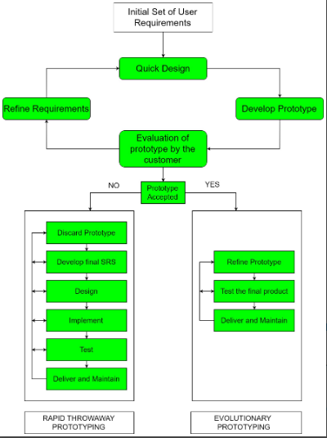

Slide 12
Summary
In Software Engineering, Prototype methodology is a software development model in which a prototype is built, test and then reworked when needed until an acceptable prototype is achieved.
1) Requirements gathering and analysis, 2) Quick design, 3) Build a Prototype, 4) Initial user evaluation, 5) Refining prototype, 6)Implement Product and Maintain; are the basic steps of the prototyping process
Type of prototyping models are 1) Rapid Throwaway prototypes 2) Evolutionary prototype
Regular meetings are essential to keep the project on time and avoid costly delays in prototyping approach.
Missing functionality can be identified, which helps to reduce the risk of failure as Prototyping is also considered as a risk reduction activity in SDLC.
Prototyping may encourage excessive change requests.

Slide 13
Thank You!

